Slide 1
Computer Network Protocols (CNP)
Internet Protocol
Objectives
Upon completion you will be able to:
Understand the format and fields of a datagram
Understand the need for fragmentation and the fields involved
Understand the options available in an IP datagram
Be able to perform a checksum calculation
Understand the components and interactions of an IP package
TCP/IP Protocol Suite

Slide 2
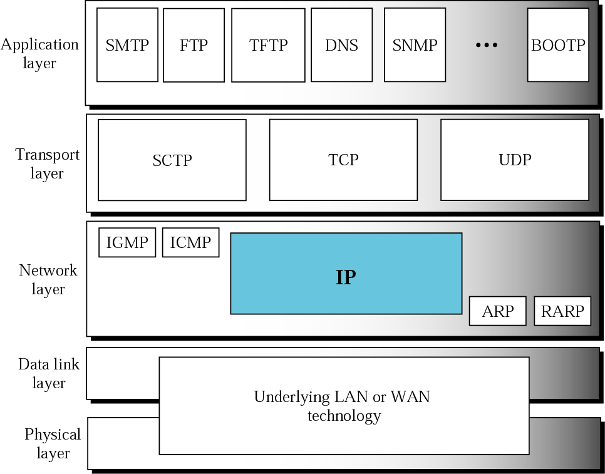
Position of IP in TCP/IP protocol suite
The Internet Protocol (IP) is the transmission mechanism used by the TCP/IP protocols at the network layer
TCP/IP Protocol Suite

Slide 3
IP is an unreliable and connectionless datagram protocol—a best-effort delivery service.
IP packets can be corrupted, lost, arrive out of order, or delayed and may create congestion for the network.
If reliability is important, IP must be paired with a reliable protocol such as TCP.
Ex: normal post vs registered post.
TCP/IP Protocol Suite

Slide 4
IP is a connectionless protocol.
Each datagram is handled independently, and each datagram can follow a different route to the destination.
Datagrams sent by the same source to the same destination could arrive out of order.
Some could be lost or corrupted during transmission.
IP relies on a higher-level protocol to take care of all these problems.
TCP/IP Protocol Suite

Slide 5
Packets in the network (internet) layer are called datagrams.
A datagram is a variable-length packet consisting of two parts: header and data.
The header is 20 to 60 bytes in length and contains information essential to routing and delivery.
TCP/IP Protocol Suite

Slide 6
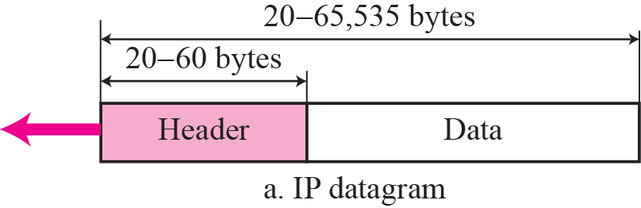
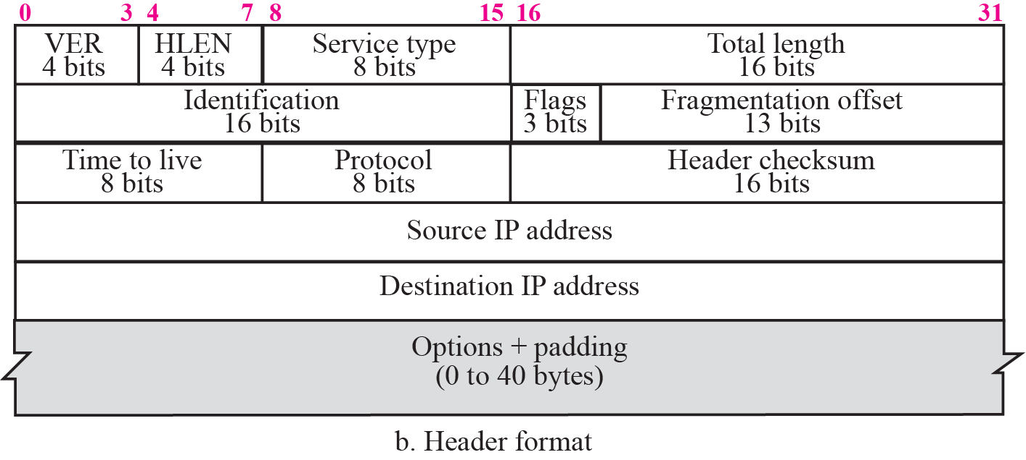
IP datagram
Figure : the IP datagram format.
TCP/IP Protocol Suite

Slide 7
IP datagram
Header length (HLEN)
Defines the total length of the datagram header.
This field is needed because the length of the header is variable (between 20 and 60 bytes).
When there are no options, the header length is 20 bytes, and the value of this field is 5 (5 × 4 = 20).
When the option field is at its maximum size, the value of this field is 15 (15 × 4 = 60).
TCP/IP Protocol Suite

Slide 8
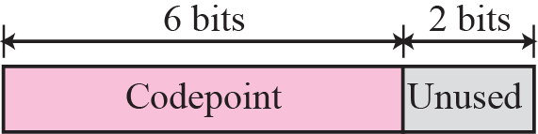
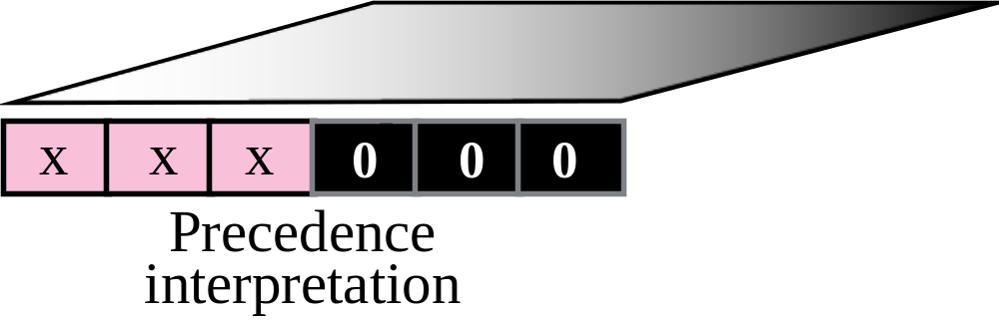
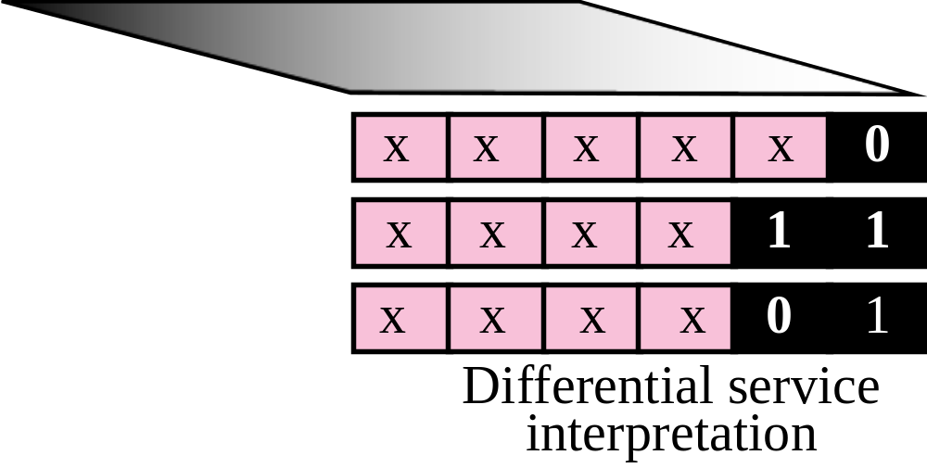
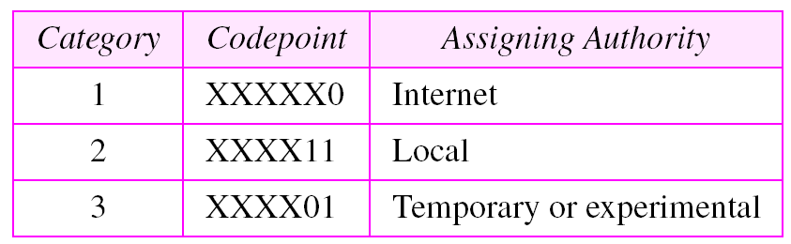
Service Type
Defined how the datagram should be handled.
Part of the field was used to define the precedence of the datagram;
TCP/IP Protocol Suite
24+16+16

Slide 9
Total length
Defines the total length (header plus data) of the IP datagram in bytes.
To find the length of the data coming from the upper layer, subtract the header length from the total length.
Length of data = total length − header length
TCP/IP Protocol Suite

Slide 10

Note:
The total length field defines the total length of the datagram including the header.
TCP/IP Protocol Suite

Slide 11
Total length
Many cases we really do not need the value in this field.
There are occasions in which the datagram is not the only thing encapsulated in a frame; it may be that padding has been added.
Ex: Ethernet protocol has a minimum and maximum restriction on the size of data that can be encapsulated in a frame (46 to 1500 bytes).
If the size of an IP datagram is less than 46 bytes, some padding will be added to meet this requirement.
TCP/IP Protocol Suite

Slide 12
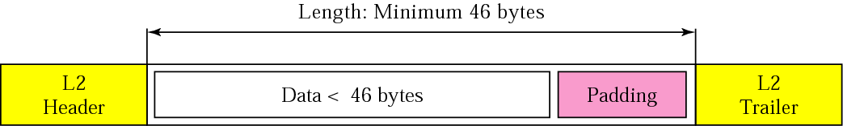
Figure 8.4 Encapsulation of a small datagram in an Ethernet frame
TCP/IP Protocol Suite

Slide 13
Time to live
A datagram has a limited lifetime in its travel through an internet. Originally designed to hold a timestamp.
Issue : synchronized clocks and must know how long it takes for a datagram to go from one machine to another.
Today, this field is mostly used to control the maximum number of hops (routers) visited by the datagram.
When a source host sends the datagram, it stores a number in this field. This value is approximately two times the maximum number of routes between any two hosts.
Each router that processes the datagram decrements this number by one. If this value, after being decremented, is zero, the router discards the datagram.
TCP/IP Protocol Suite
Notes:
1 ICMP 2 IGMP 6 TCP 17 UDP 89 OSPF

Slide 14
Time to live
This field is needed because routing tables in the Internet can become corrupted.
A datagram may travel between two or more routers for a long time without ever getting delivered to the destination host.
This field limits the lifetime of a datagram.
Another use of this field is to intentionally limit the journey of the packet.
For example, if the source wants to confine the packet to the local network, it can store 1 in this field.
TCP/IP Protocol Suite
Notes:
1 ICMP 2 IGMP 6 TCP 17 UDP 89 OSPF

Slide 15
Protocol
This 8-bit field defines the higher-level protocol that uses the services of the IP layer.
An IP datagram can encapsulate data from several higher level protocols such as TCP, UDP, ICMP.
This field specifies the final destination protocol to which the IP datagram should be delivered.
TCP/IP Protocol Suite
Notes:
1 ICMP 2 IGMP 6 TCP 17 UDP 89 OSPF

Slide 16
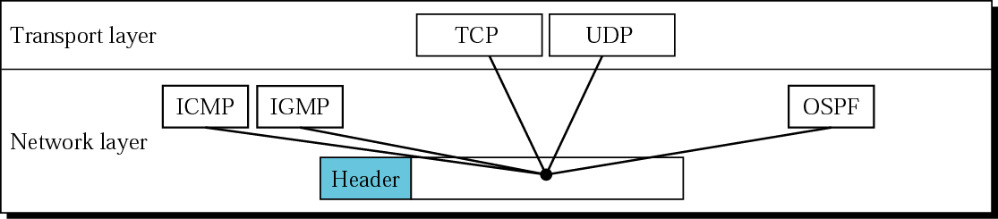
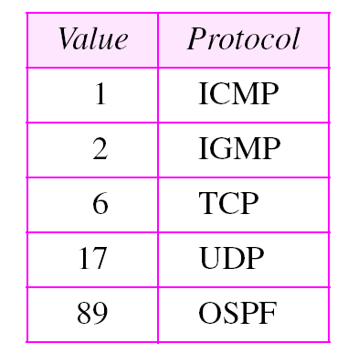
Figure 8.5 Multiplexing
TCP/IP Protocol Suite
Table 8.4 Protocols
Notes:
1 ICMP 2 IGMP 6 TCP 17 UDP 89 OSPF

Slide 17
Example 1
An IP packet has arrived with the first 8 bits as shown:
01000010
The receiver discards the packet. Why?
TCP/IP Protocol Suite

Slide 18
Example 1
An IP packet has arrived with the first 8 bits as shown:
01000010
The receiver discards the packet. Why?
Solution
There is an error in this packet. The 4 left-most bits (0100) show the version, which is correct. The next 4 bits (0010) show the header length; which means (2 × 4 = 8), which is wrong. The minimum number of bytes in the header must be 20. The packet has been corrupted in transmission.
TCP/IP Protocol Suite

Slide 19
Example 2
In an IP packet, the value of HLEN is 1000 in binary. How many bytes of options are being carried by this packet?
TCP/IP Protocol Suite

Slide 20
Example 2
In an IP packet, the value of HLEN is 1000 in binary. How many bytes of options are being carried by this packet?
Solution
The HLEN value is 8, which means the total number of bytes in the header is 8 × 4 or 32 bytes. The first 20 bytes are the base header, the next 12 bytes are the options.
TCP/IP Protocol Suite

Slide 21
Example 3
In an IP packet, the value of HLEN is 5₁₆
and the value of the total length field is 0028₁₆ . How
many bytes of data are being carried by this packet?
TCP/IP Protocol Suite

Slide 22
Example 3
In an IP packet, the value of HLEN is 5₁₆
and the value of the total length field is 0028₁₆ . How
many bytes of data are being carried by this packet?
Solution
The HLEN value is 5, which means the total number of bytes in the header is 5 × 4 or 20 bytes (no options). The total length is 40 bytes, which means the packet is carrying 20 bytes of data (40 − 20).
TCP/IP Protocol Suite

Slide 23
Example 4
An IP packet has arrived with the first few hexadecimal digits as shown below:
45000028000100000102 . . .
How many hops can this packet travel before being dropped? The data belong to what upper layer protocol?
Solution
To find the time-to-live field, we skip 8 bytes (16 hexadecimal digits). The time-to-live field is the ninth byte, which is 01. This means the packet can travel only one hop. The protocol field is the next byte (02), which means that the upper layer protocol is TCP.
TCP/IP Protocol Suite

Slide 24
End
TCP/IP Protocol Suite

